Slide 1

Sunday Otters
Final Project CST- 205

Slide 2
Spongebob Squarepants Adventure Game
Team Sunday Otters created an strategy based text game
SpongeBob SquarePants was the idea of our
team member Vasile Danciu.
For group work Sunday Otters used GitHub.

Slide 3
Individial Assignments
Vasile Danciu – story, descriptions, code, debug, test
Lavinia Uruc – power point presentation, some descriptions, debug and test
Josh Jones - debug and test

Slide 4
How it got done
Sunday Otters team members helped each other in achieving the goal of completing the game.

Slide 5
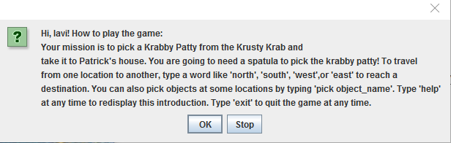
Demo
The game is based on the cartoon with the same name Spongebob Squarepants
The game starts with asking the player of his/her name.
Then follows a small how to play window as seem bellow.

Slide 6
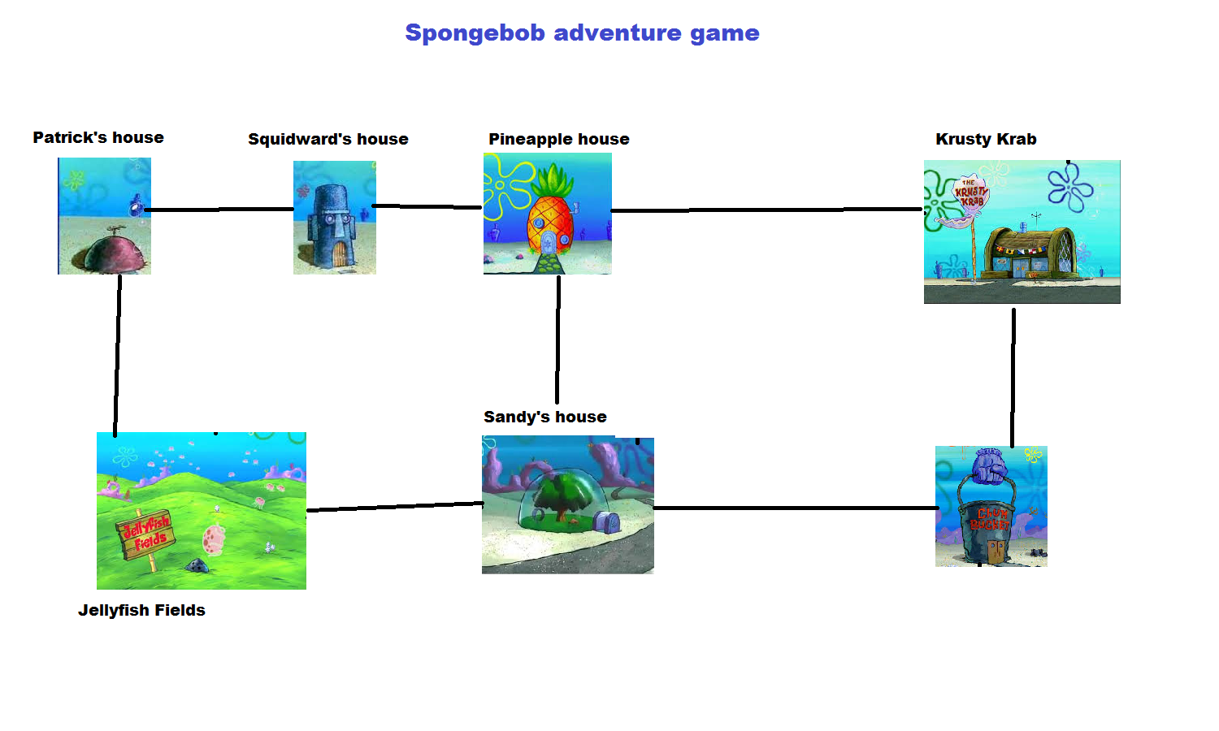
Game map – the map is helpful when trying to understand the layout of the game

Slide 8
How to play
In the following slides you will be introduced to each of the possible games locations.
In order to wind the game you need to find Pineapple House and type “pick spatula”
The spatula has to be taken to Krusty Krabby to “pick patty”
The patty has to be delivered to Patrick’s house to win the game and for Patrick to enjoy his delicious meal.

Slide 9
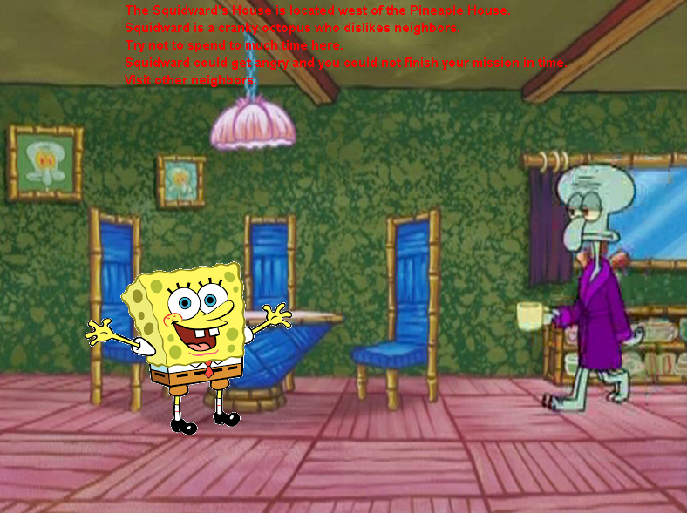
Squidward’s House

Slide 10
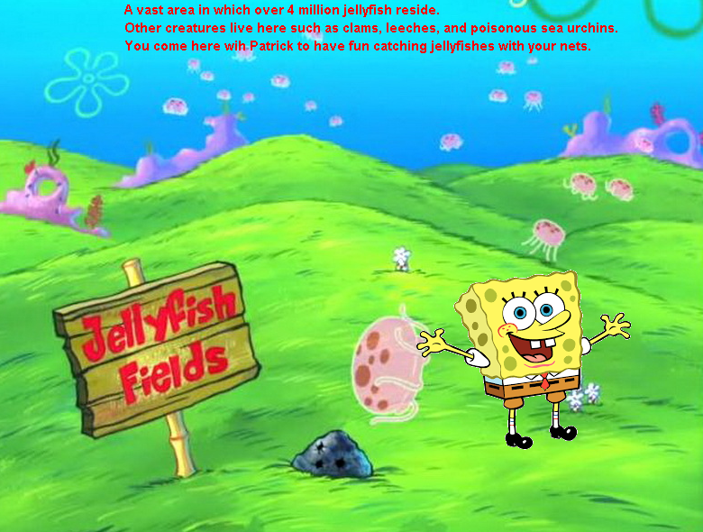
Jellyfish Fields

Slide 11
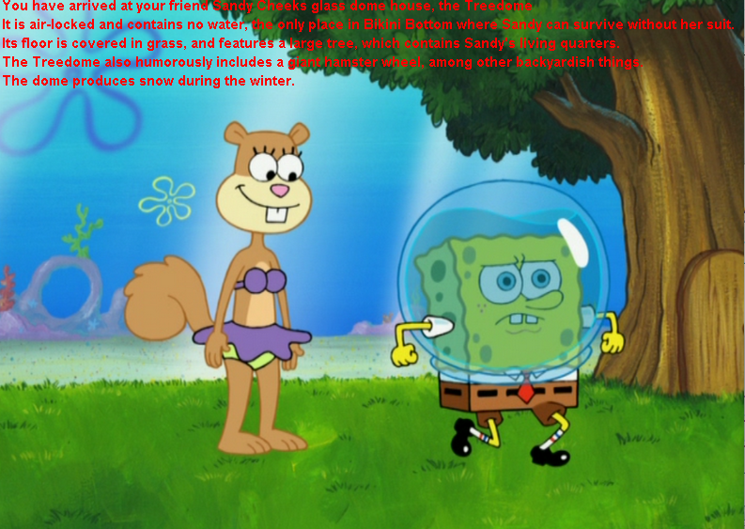
Sandy’s House

Slide 12
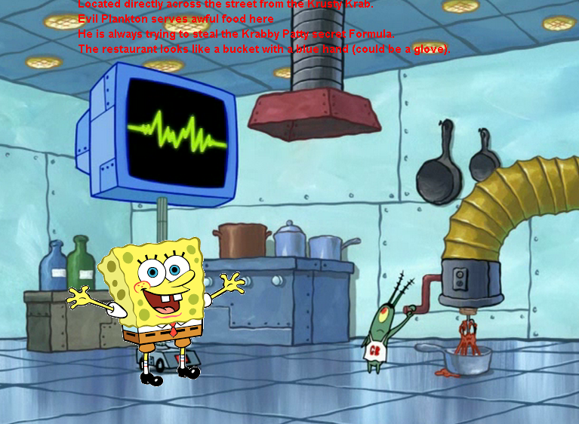
Chum Bucket

Slide 13
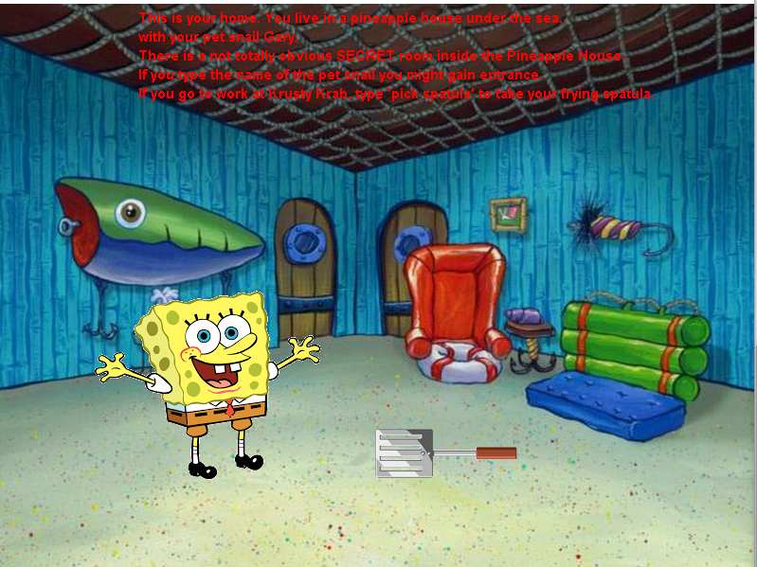
Pineapple house – here you can type “pick spatula” and you pick the spatula to take it to Krusty Krab

Slide 14
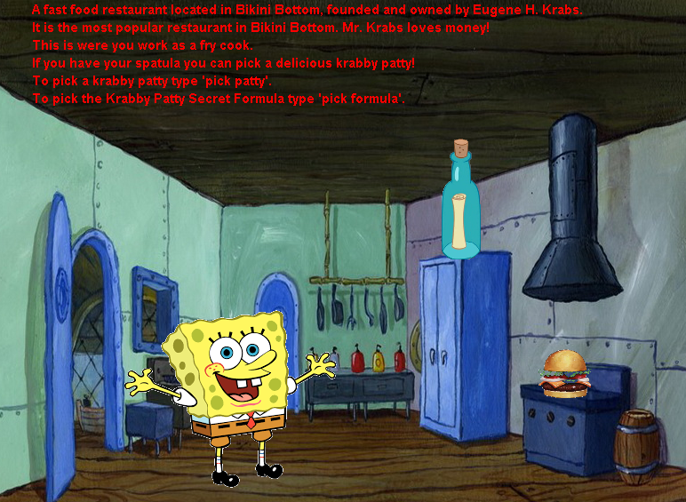
Krusty Krub – here you can type “pick patty” and you take the patty to Patrick’s House

Slide 15
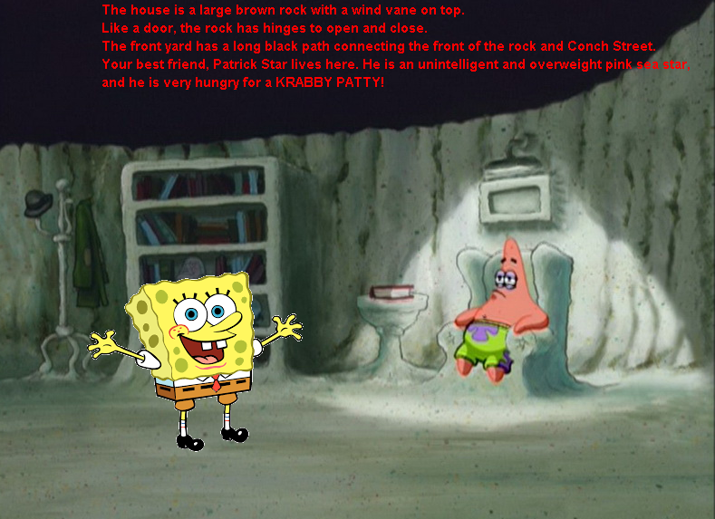
Patrick’s House – at the end of the game after you pick the spatula and the patty you will deliver the patty to Patrick so he can enjoy a delicious krabby patty. If you get here…you won the game. Congratulations!!!

Slide 16
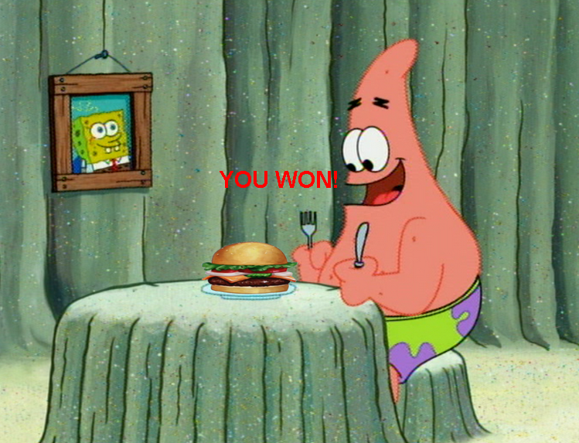
Patrick happy to enjoy a good meal!!

Slide 17
Three things Sunday Otters Leaned
Team work is important
Finishing assignments on time
Team communication is key

Slide 18
Three skills Sunday Otters developed
Social programming
Python programming experience
Time management

Slide 19
Link to Sunday Otters group status
https://docs.google.com/document/d/19TRpB37EHxolNVHuJg0AGfoS5TOmmpvKwUiFoFrrsfE/edit

